Slide 1
l
StegoCrypt - Image Steganography Tool
CAPSTONE PROJECT
Presented By: Tanmay Devidas Khairnar
Student Name : Tanmay Devidas Khairnar
College Name : R.H SAPAT COLLEGE OF ENGINEERING
Department : Electronics & Telecommunication Engineering

Slide 2
OUTLINE
Problem Statement
Technology used
Wow factor
End users
Result
Conclusion
Git-hub Link
Future scope

Slide 3
Problem Statement
🔹 Traditional encryption methods are easily identifiable and can attract unwanted attention. 🔹 There is a need for a covert way to hide confidential messages without raising suspicion. 🔹 Ensuring data security while preserving the visual integrity of the original image is crucial. 🔹 Many existing encryption tools are complex—a user-friendly solution is needed for both technical and non-technical users.

Slide 4
Technology used
🔹 Programming Language: Python – Core language used for encryption and decryption logic.
🔹 Image Processing: OpenCV – Enables embedding and extracting secret messages at the pixel level.
🔹 Data Handling: NumPy – Efficiently processes and manipulates image pixel values.
🔹 Security Mechanism: Password-based access control ensures only authorized decryption.
🔹 Platform Compatibility: Works on Windows, Linux, and macOS, provided Python & OpenCV are installed.

Slide 5
Wow factors
🔹 Invisible Data Hiding: Embeds a secret message inside an image without any visible distortion.
🔹 No Traditional Encryption: Uses pixel value manipulation instead of standard cryptographic methods, making detection extremely difficult.
🔹 Lossless Steganography: The original image remains intact, ensuring that no quality loss occurs.
🔹 Universal Compatibility: Works with any PNG or uncompressed image format for secure message hiding.
🔹 Lightweight & Fast: Minimal dependencies, runs efficiently on any system with Python & OpenCV installed.

Slide 6
End users
🔹 Cybersecurity Enthusiasts – Learn and experiment with covert communication techniques.
🔹 Government & Defense Personnel – Transmit classified messages without raising suspicion.
🔹 Journalists & Activists – Securely embed sensitive information in images to bypass censorship.
🔹 Ethical Hackers & Researchers – Explore steganography concepts for security analysis and forensic investigations.
🔹 General Users – Protect personal or confidential messages without complex encryption tools.

Slide 7
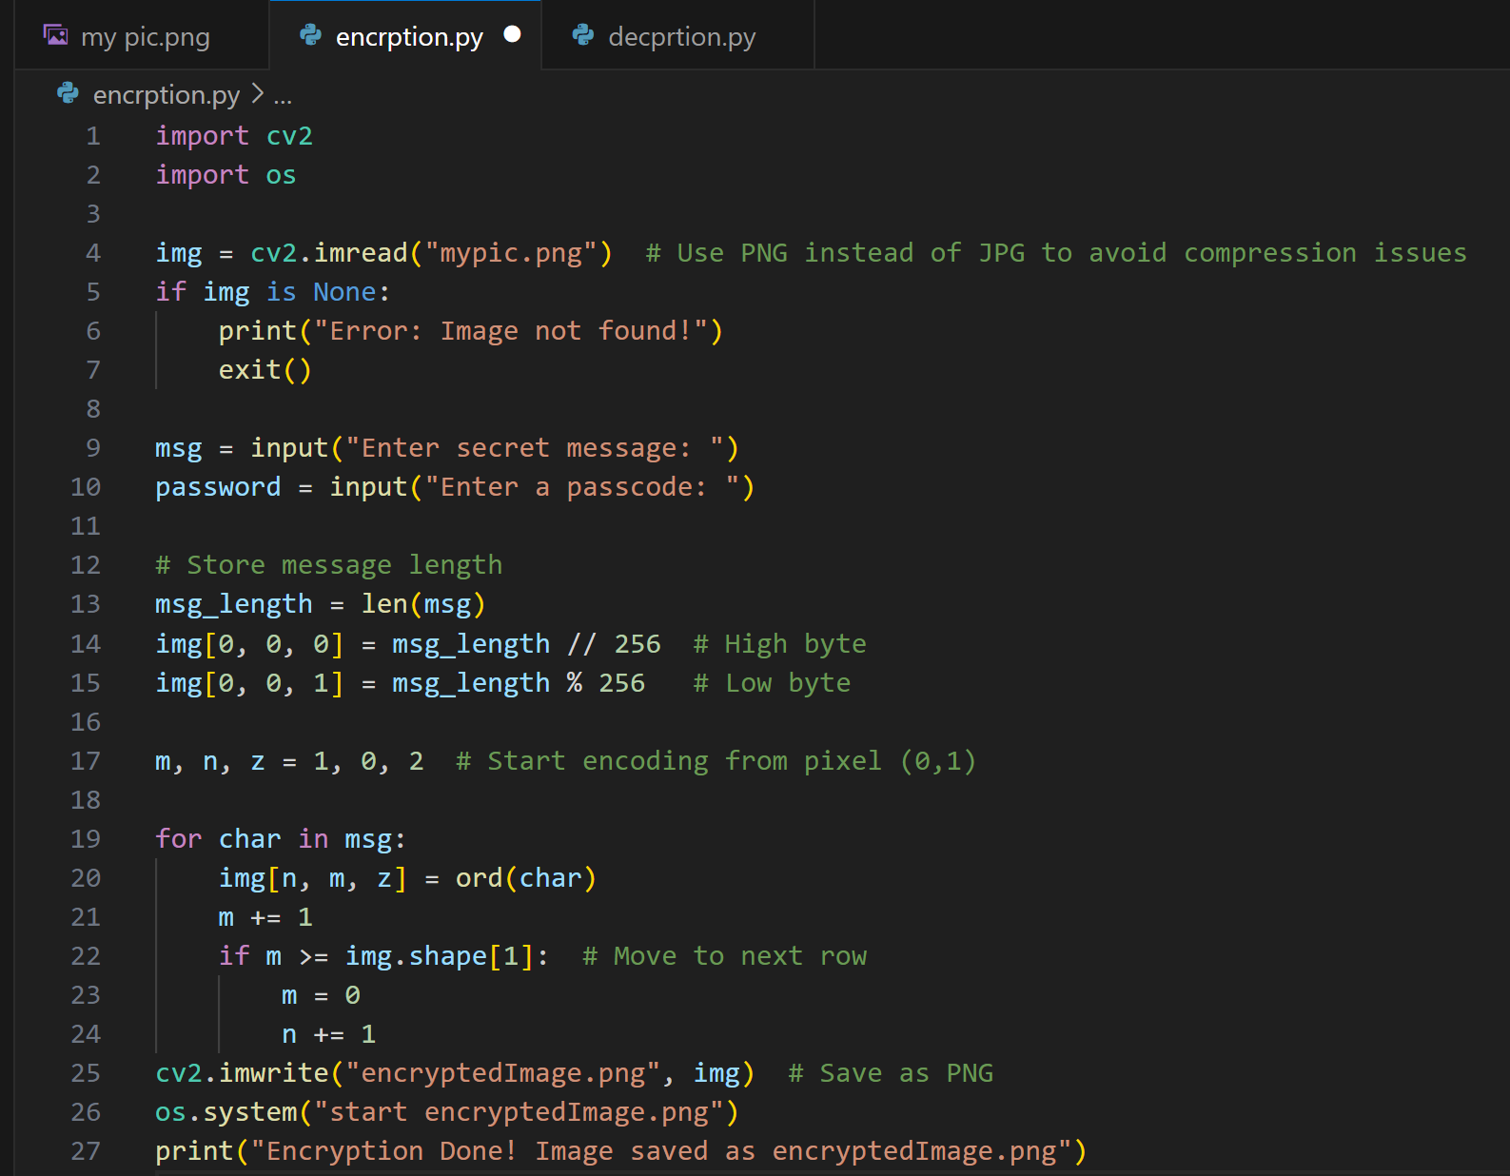
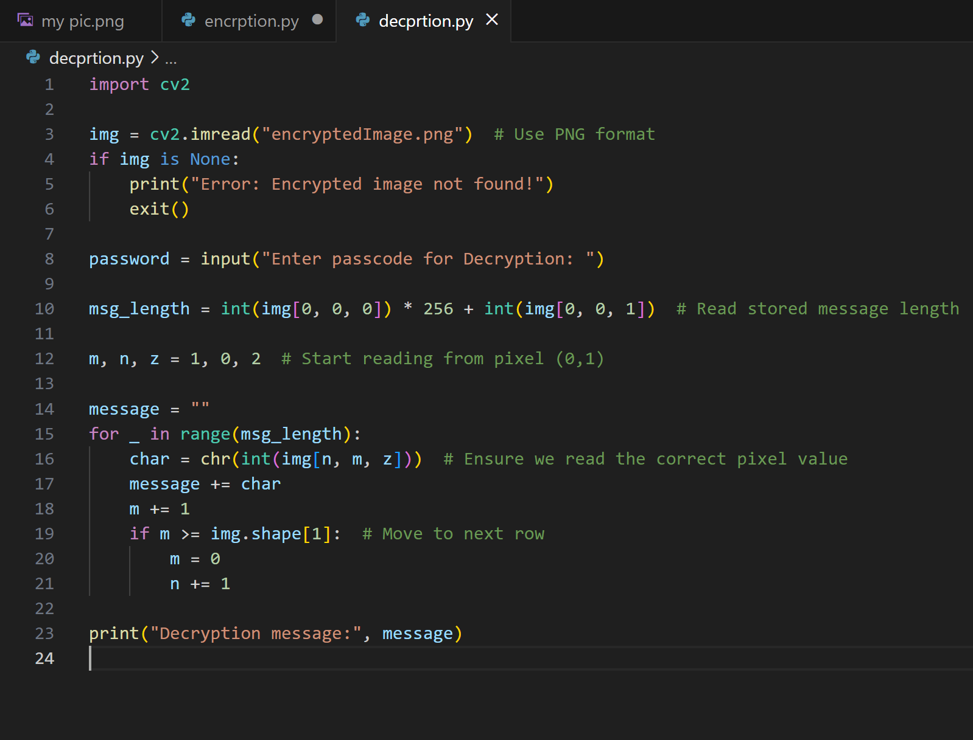
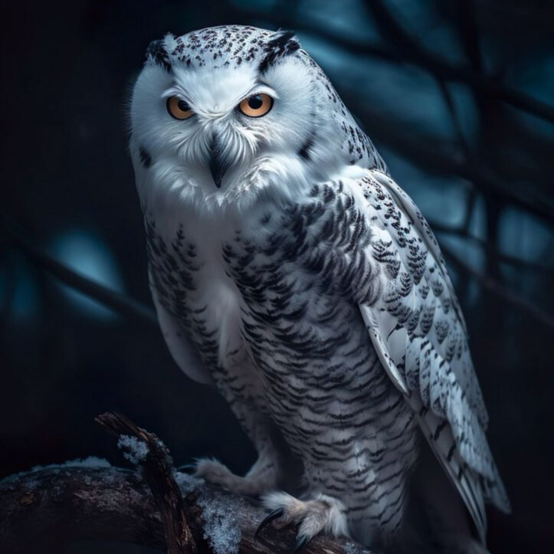

Results Encryption Code & Normal image Decryption Code & Encrpted Image

Slide 8
Conclusion
🔹 Steganography offers a covert and undetectable way to transmit sensitive information securely.
🔹 This project demonstrates a simple yet effective method for hiding and retrieving messages in images using OpenCV.
🔹 The approach ensures lossless data hiding, preserving the original image quality while embedding secret text.
🔹 Future enhancements could improve security, efficiency, and compatibility with more image formats and advanced encryption techniques.

Slide 9
GitHub Link
https://github.com/tanmay0409/StegoCrypt-Image-Steganography-Tool.git

Slide 10
Future scope(optional)
🔹 Enhanced Security: Integrate stronger encryption algorithms to further protect hidden messages.
🔹 Support for More Image Formats: Expand compatibility beyond PNG to include JPG, BMP, and GIF while minimizing data loss.
🔹 Increased Data Capacity: Optimize pixel manipulation techniques to store larger messages without affecting image quality.
🔹 Error Detection & Correction: Implement mechanisms to detect and recover corrupted or tampered messages.
🔹 Cross-Platform Tool: Develop a standalone application or web-based interface for easier access without requiring Python installation.

Slide 11
THANK YOU

